Slide 1
CS 0007: Introduction to Java
Lecture 6
Nathan Ong
University of Pittsburgh
September 20, 2016

Slide 2
Scanners
Even more API for your first Object

Slide 3

Scanner
Notes:
https://upload.wikimedia.org/wikipedia/en/thumb/2/27/AScannerDarkly%281stEd%29.jpg/200px-AScannerDarkly%281stEd%29.jpg

Slide 4
What is a Scanner?
Retrieves input
Can take input from a file, an input stream (console, network, etc.), or from a String
Can read all primitives (except chars), and can read Strings
An object

Slide 5
Declaring Objects
Type name = expression;

Slide 6
Scanner name = new Scanner();
We will fill this in with something,
but what exactly goes here?

Slide 7
Declaring Objects
Any declaration of objects requires the keyword “new”
The method that follows the keyword are called constructors
Where can I look for them?

Slide 8
A Special InputStream
System.in
The standard way to retrieve input (via the console)
A “special” variable.
Is this static or non-static?

Slide 9
Scanner consoleInput =
new Scanner(System.in);

Slide 10
What can I do with it?
I have a Scanner that can read input from the user via the console.
How do I actually use it?

Slide 11
Using Scanner
public class AddingMachine
{
public static void main(String[] args)
{
Scanner scan = new Scanner(System.in);
System.out.println("Please enter a number:");
double firstNum = scan.nextDouble();
System.out.println("Please enter a second number:");
double secondNum = scan.nextDouble();
double sum = firstNum + secondNum;
System.out.println("The sum of " + firstNum +
" and " + secondNum + " equals " + sum);
}//end method main
}//End class AddingMachine

Slide 12
Using Scanner
public class AddingMachine
{
public static void main(String[] args)
{
Scanner scan = new Scanner(System.in);
System.out.println("Please enter a number:");
double firstNum = scan.nextDouble();
System.out.println("Please enter a second number:");
double secondNum = scan.nextDouble();
double sum = firstNum + secondNum;
System.out.println("The sum of " + firstNum +
" and " + secondNum + " equals " + sum);
}//end method main
}//End class AddingMachine

Slide 13
Using Scanner
public class AddingMachine
{
public static void main(String[] args)
{
Scanner scan = new Scanner(System.in);
System.out.println("Please enter a number:");
double firstNum = scan.nextDouble();
System.out.println("Please enter a second number:");
double secondNum = scan.nextDouble();
double sum = firstNum + secondNum;
System.out.println("The sum of " + firstNum +
" and " + secondNum + " equals " + sum);
}//end method main
}//End class AddingMachine

Slide 14
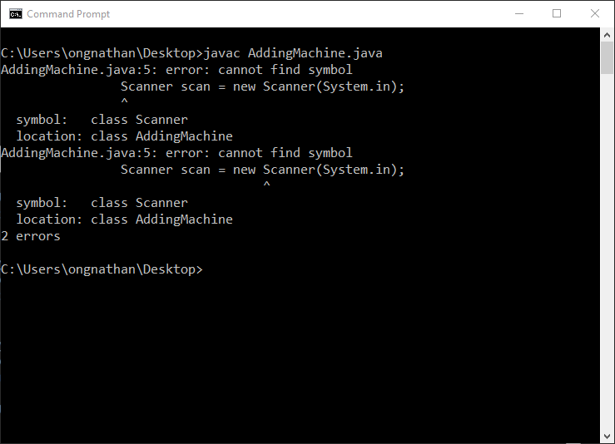
Let’s Compile
???

Slide 15
Error?!?
“Cannot find symbol”
This indicates that the name does not refer to anything
Based on the console output, “Scanner” does not exist
Is there a way to figure out why?

Slide 16
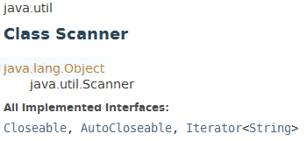
From the API

Slide 17
Error?!?
Rather than being a part of “java.lang,” which is already included by default, it is part of a different package
In order to include Scanner, we need to do an import

Slide 18
import java.util.Scanner;
public class AddingMachine
{
public static void main(String[] args)
{
Scanner scan = new Scanner(System.in);
System.out.println("Please enter a number:");
double firstNum = scan.nextDouble();
System.out.println("Please enter a second number:");
double secondNum = scan.nextDouble();
double sum = firstNum + secondNum;
System.out.println("The sum of " + firstNum +
" and " + secondNum + " equals " + sum);
}//end method main
}//End class AddingMachine

Slide 19
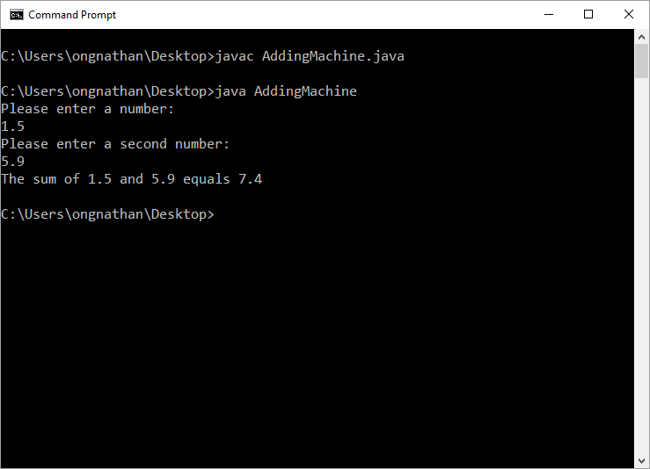
Don’t Forget to Import

Slide 20
Functions

Slide 21
Functions
A function is similar to its mathematical counterpart
f(x) = x², plug in 3, get 9
Contains several more parts

Slide 22
Java Functions
Takes in zero or more parameters, processes them in the function body, and returns a result
Imagine going to BestBuyTM and telling them you want your computer fixed. You are telling them to run a fixing function, with your computer being a parameter. What you get back is your fixed computer.

Slide 23
You Already Have the Power!
You already know how to call functions!
Static:
ClassName.functionName(<parameters>);
Non-static: objectName.functionName(<parameters>);
How do I make my own?
Notes:
calling ClassName.staticFunction() is only necessary when the function being called is in another class

Slide 24
Function Components
Visibility type (public/protected/private)
static (For now, required)
Return Type
functionName
Parentheses “()”
  Parameters
  Type1 parameterName1
  Type2 parameterName2
  …
Curly Brackets/Braces “{}”
  return a value
Function
Header
Function
Body

